Slide 1


IOT BASED GAS LEAKAGE DETECTION SYSTEM
PRESENTED BY
1.MEENAA.K(2017504018)
2.NISHANTH.R(2017504024)
3.PARTHIBAN.A(2017504027)

Slide 2
OVERVIEW
Tools required
Block Diagram
Circuit Diagram
Setup of Adafruit
Program
Output
Application

Slide 3
MOTIVATION
Develop a gas leakage detection and monitoring system to avoid accidents and control home device depending upon the gas level.

Slide 4
TOOLS REQUIRED
HARDWARE:
NodeMCU ESP8266
MQ-2 gas sensor
Relay
Resistor
Buzzer
SOFTWARE:
Arduino IDE software

Slide 5
BLOCK DIAGRAM
MQTT
MONITOR THE DATA
MOBILE PHONE
MQTT
PUBLISH THE DATA
SUBSCRIBE THE DATA
MICROCONTROLLER(ESP8266)
PUBLISH THE DATA
MICROCONTROLLER(ESP8266)
RELAY
SENSOR
HOME DEVICE

Slide 6
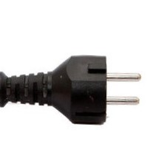
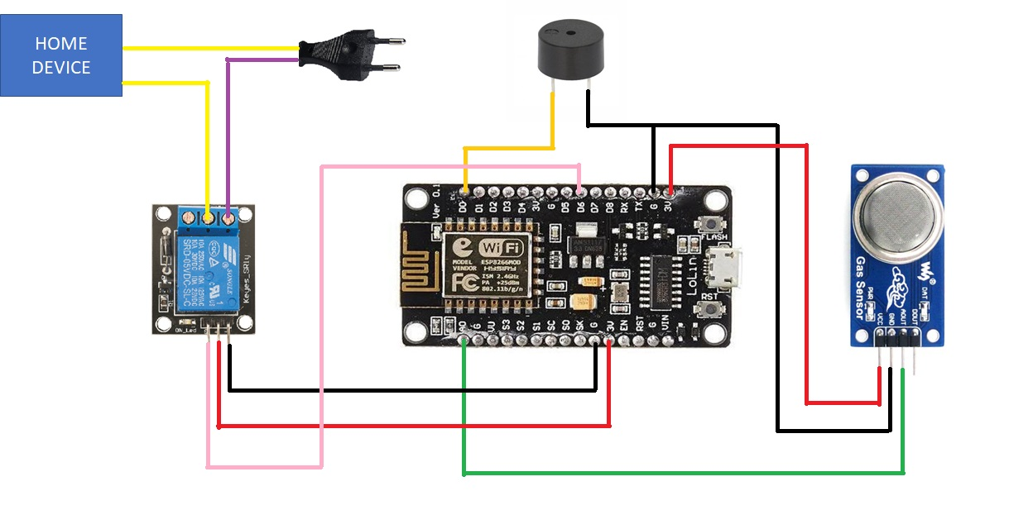
CIRCUIT DIAGRAM

Slide 7
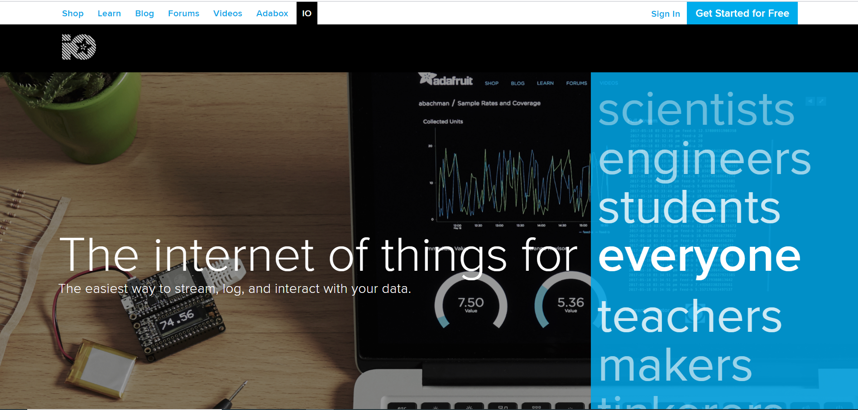
SETUP OF ADAFRUIT

Slide 8
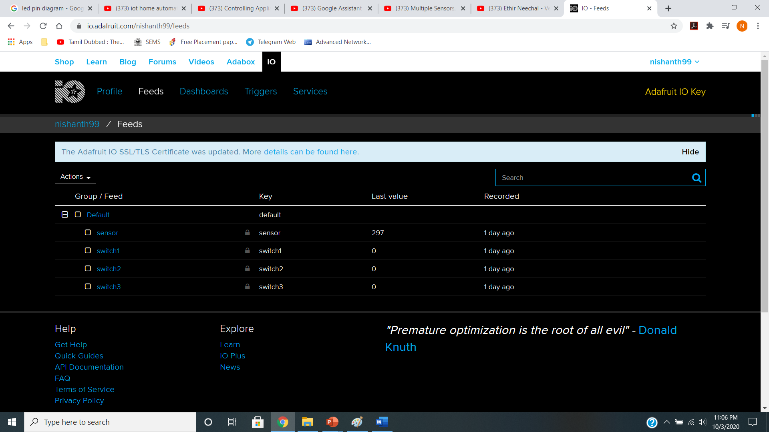

Slide 9
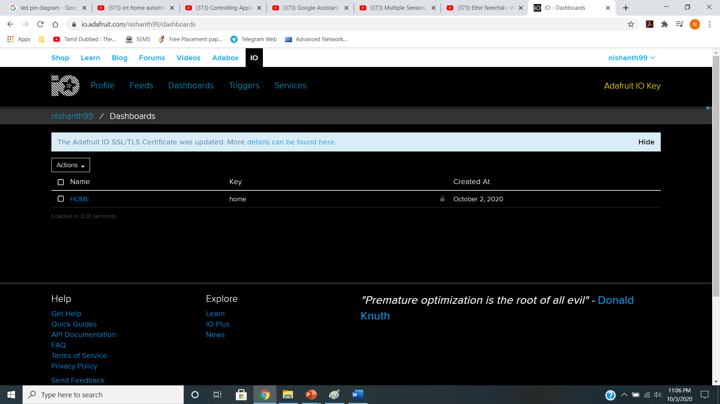

Slide 10
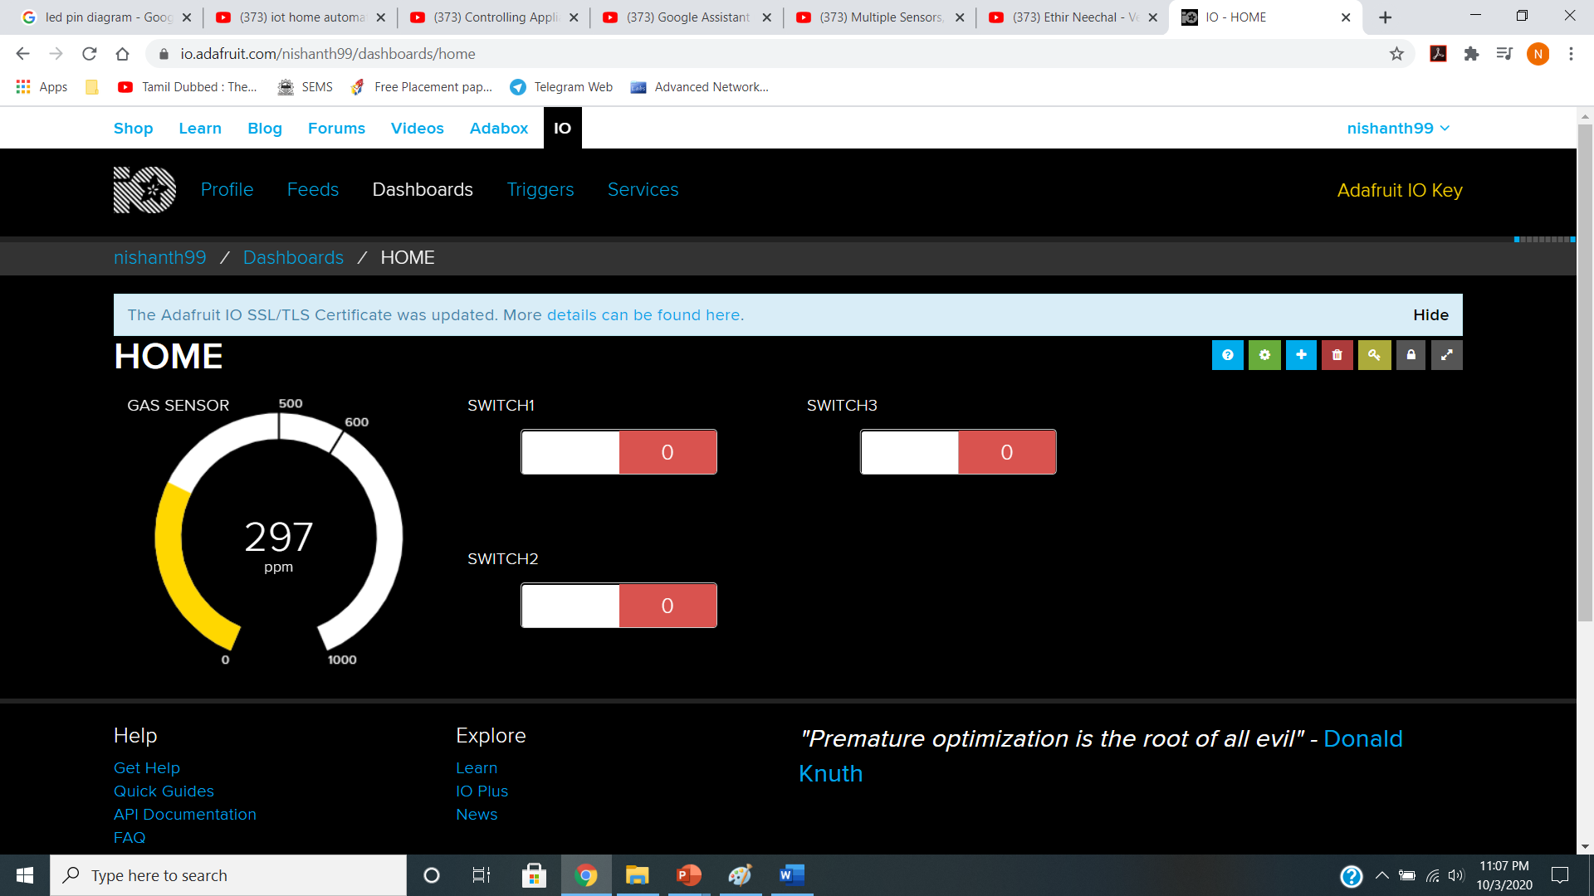

Slide 11
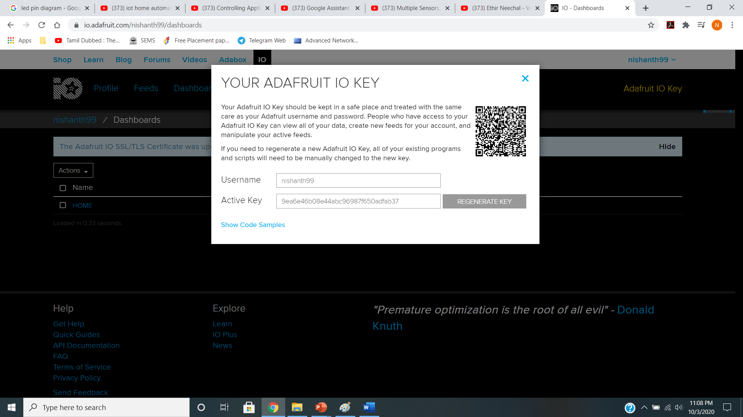

Slide 12
PROGRAM
TO INCLUDE THE HEADER FILES
#include <ESP8266WiFi.h>
#include "Adafruit_MQTT.h"
#include "Adafruit_MQTT_Client.h"
PIN DEFINITION
//Relays for switching appliances
#define Relay1 D6
#define Relay2 D2
#define Relay3 D1
//buzzer to know the status of MQTT connections and threshold value of sensor
#define buzzer D0
//Analog pin to read the incoming analog value from different sensors
#define analogpin A0

Slide 13
SETTING UP WIFI ACCESS POINT AND ADAFRUIT ACCOUNT DETAILS
#define WLAN_SSID "Airtel"
#define WLAN_PASS "airtelwifi"
#define AIO_SERVER "io.adafruit.com"
#define AIO_SERVERPORT 1883
#define AIO_USERNAME "nishanth99"
#define AIO_KEY "9ea6e46b08e44abc96987f650adfab37“
// Create an ESP8266 WiFiClient class to connect to the MQTT server
WiFiClient client;
// Setup the MQTT client class by passing in the WiFi client and MQTT server and login details
Adafruit_MQTT_Client mqtt(&client, AIO_SERVER, AIO_SERVERPORT, AIO_USERNAME, AIO_KEY);
// Notice MQTT paths for AIO follow the form: <username>/feeds/<feedname>
Adafruit_MQTT_Publish sensor = Adafruit_MQTT_Publish(&mqtt, AIO_USERNAME "/feeds/sensor");
Adafruit_MQTT_Publish light11 = Adafruit_MQTT_Publish(&mqtt, AIO_USERNAME "/feeds/switch1");
Adafruit_MQTT_Subscribe light1 = Adafruit_MQTT_Subscribe(&mqtt, AIO_USERNAME "/feeds/switch1");
Adafruit_MQTT_Subscribe light2 = Adafruit_MQTT_Subscribe(&mqtt, AIO_USERNAME "/feeds/switch2");
Adafruit_MQTT_Subscribe light3 = Adafruit_MQTT_Subscribe(&mqtt, AIO_USERNAME "/feeds/switch3");

Slide 14
SKETCH CODE
void MQTT_connect();
void setup() {
Serial.begin(115200);
delay(10);
pinMode(buzzer, OUTPUT);
pinMode(Relay1, OUTPUT);
pinMode(Relay2, OUTPUT);
pinMode(Relay3, OUTPUT);
pinMode(A0, INPUT);
Serial.println(F("Adafruit MQTT demo"));
// Connect to WiFi access point.
Serial.println(); Serial.println();
Serial.print("Connecting to ");
Serial.println(WLAN_SSID);
WiFi.begin(WLAN_SSID, WLAN_PASS);
while (WiFi.status() != WL_CONNECTED) {
delay(500);
Serial.print(".");
}
Serial.println();
Serial.println("WiFi connected");
Serial.println("IP address: "); Serial.println(WiFi.localIP());
// Setup MQTT subscription for onoff feed.
mqtt.subscribe(&light1);
mqtt.subscribe(&light2);
mqtt.subscribe(&light3);
}

Slide 15
uint32_t x = 0;
void loop() {
MQTT_connect();
Adafruit_MQTT_Subscribe *subscription;
//Subscribe the topics
while ((subscription = mqtt.readSubscription(2000)))
{
if (subscription == &light1)
{
Serial.print(F("Got Light 1: "));
Serial.println((char *)light1.lastread);
int Light1_State = atoi((char *)light1.lastread);
digitalWrite(Relay1, Light1_State);
}
if (subscription == &light3)
{
Serial.print(F("Got Light 3: "));
Serial.println((char *)light3.lastread);
int Fan1_State = atoi((char *)light3.lastread);
digitalWrite(Relay3, Fan1_State);
}
}
}
// Gas detection and publish the data
Serial.print("Gas Detection ");
Serial.println(analogRead(analogpin));
Serial.print("...");
int Value = analogRead(analogpin);
sensor.publish(Value);
if(Value>580)
{
Serial.println("Gas Detected!!!");
light11.publish(1);
}
if (subscription == &light2)
{
Serial.print(F("Got Light 2: "));
Serial.println((char *)light2.lastread);
int Light2_State = atoi((char *)light2.lastread);
digitalWrite(Relay2, Light2_State);
}

Slide 16
void MQTT_connect() {
int8_t ret;
// Stop if already connected.
if (mqtt.connected()) {
return;
}
Serial.print("Connecting to MQTT... ");
uint8_t retries = 3;
digitalWrite(buzzer, HIGH);
delay(200);
digitalWrite(buzzer, LOW);
delay(200);
digitalWrite(buzzer, HIGH);
delay(200);
digitalWrite(buzzer, LOW);
delay(200);
while ((ret = mqtt.connect()) != 0)
{
// connect will return 0 for connected
Serial.println(mqtt.connectErrorString(ret));
Serial.println("Retrying MQTT connection in 5 seconds...");
mqtt.disconnect();
delay(5000); // wait 5 seconds
retries--;
if (retries == 0) {
// basically die and wait for WDT to reset me
while (1);
}
}
Serial.println("MQTT Connected!");
digitalWrite(buzzer, HIGH);
delay(2000);
digitalWrite(buzzer, LOW);
}

Slide 17
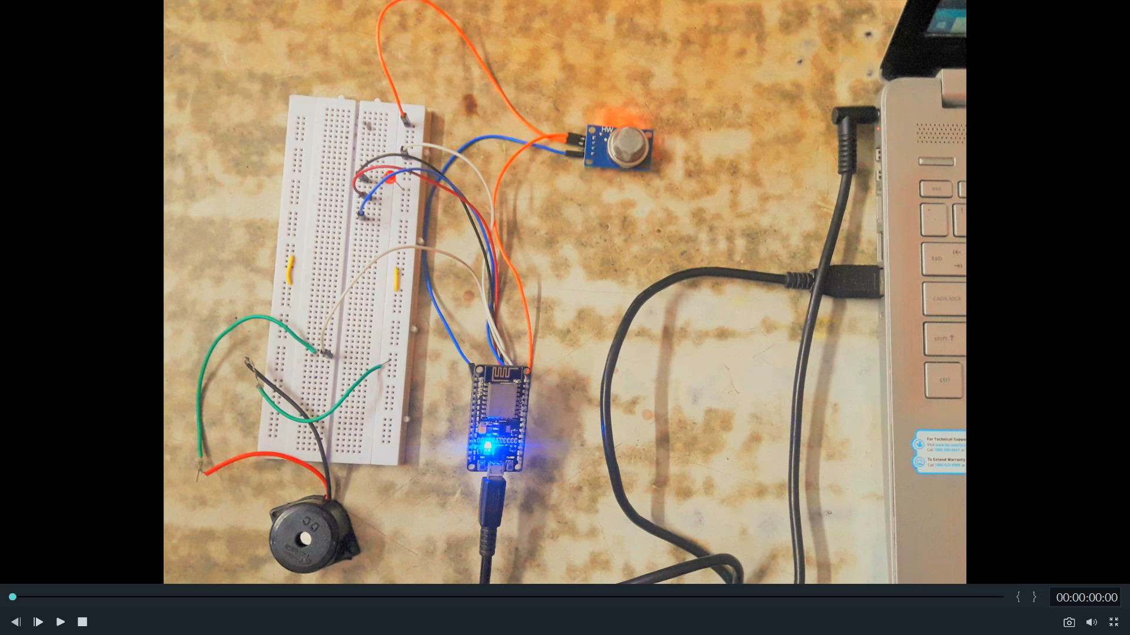
OUTPUT

Slide 18
APPLICATIONS
Can be used as a Intelligent Gas Detection System.
Can be used for security purpose.
Can be used in food processing industries.

Slide 19
THANK YOU

